Slide 2
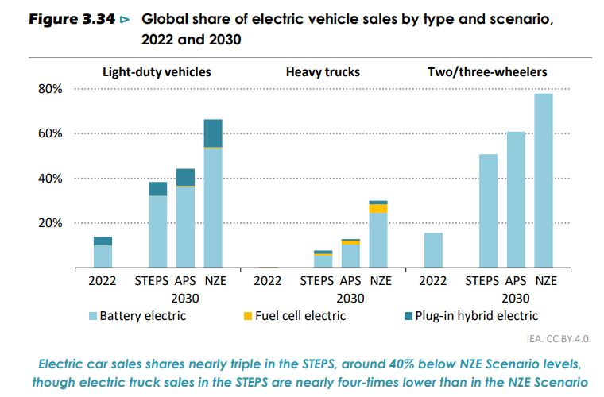

Slide 3
Two/three-wheelers already have the highest electrification shares today of any road transport mode, in particular in emerging market and developing economies, and that looks set to continue as infrastructure requirements and cost premiums are limited. However, less than 1% of heavy trucks sold today are electric, and limited progress is made in the STEPS, where sales in 2030 are nearly four-times lower than in the NZE Scenario. More widespread deployment of charging infrastructure is needed to increase the rate of heavy trucks electrification, especially in emerging market and developing economies. Deployment levels are higher for electric buses, which are already cost competitive on a lifetime basis and are often subsidised by local municipalities

Slide 4
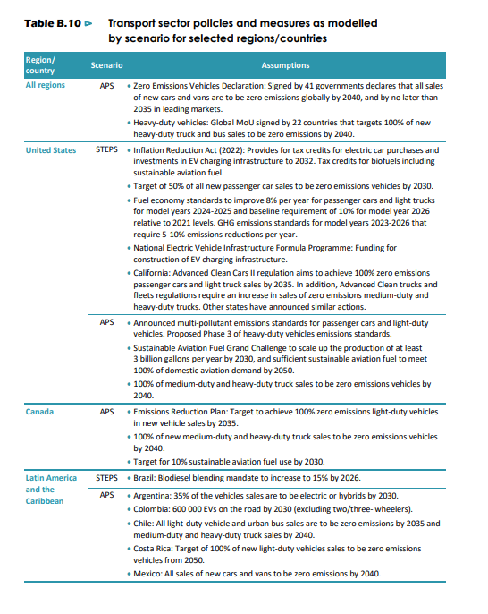










Slide 5
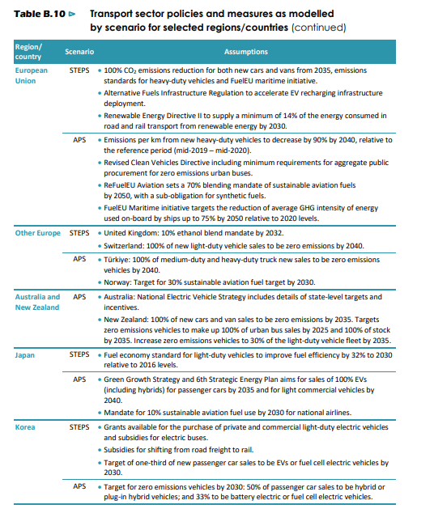







Slide 6
